Slide 1
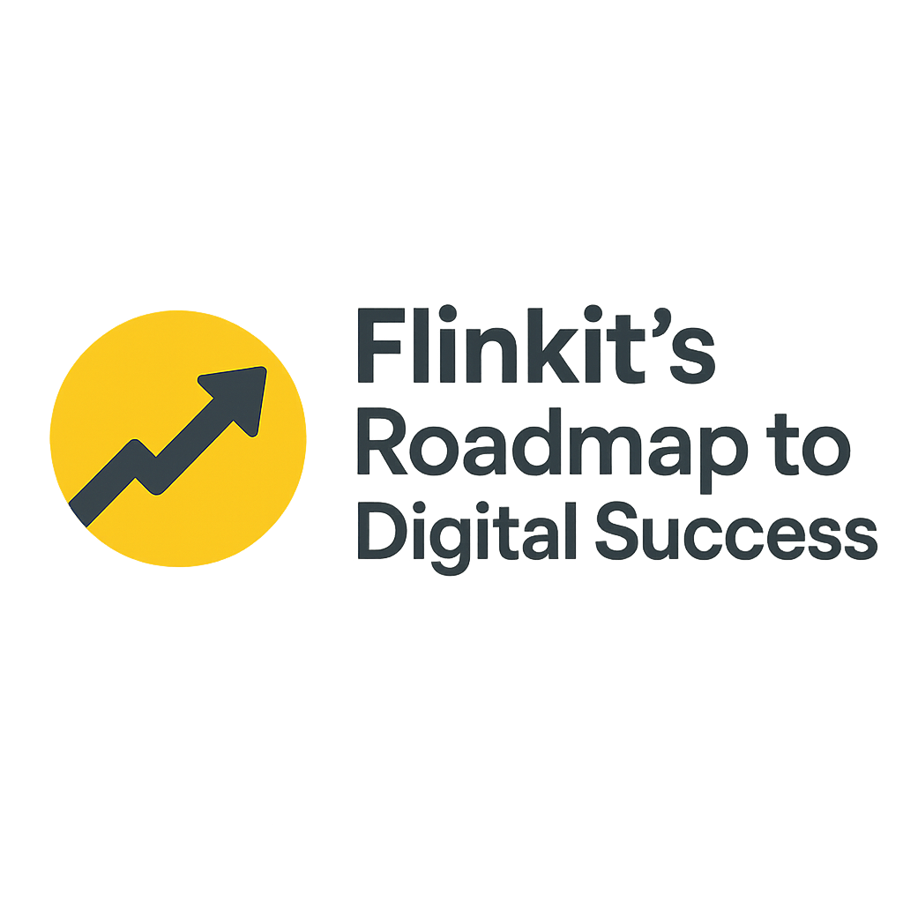

Flinkit’Roadmapto Digital Success:
Name of the Mentee

Slide 2
Introduction
🌐 Flinkit’s Roadmap to Digital SuccessIn today’s fast-paced digital world, businesses can no longer rely on traditional methods to stay competitive. Success is defined not just by having an online presence, but by building a strategic, measurable, and future-ready digital journey.Flinkit’s Roadmap to Digital Success is designed to guide organizations through every stage of transformation – from awareness and strategy to implementation, optimization, and long-term growth. It provides a clear, step-by-step framework that combines technology, marketing, and data-driven insights to help businesses unlock growth, improve customer experiences, and achieve sustainable results.With a focus on innovation and adaptability, this roadmap empowers businesses of all sizes to confidently navigate the challenges of digital transformation and seize new opportunities.

Slide 3
PROBLEM STATEMENT
Flinkit, as a rapidly growing instant delivery platform, faces the challenge of establishing a consistent, engaging, and data-driven digital presence that not only increases brand awareness but also builds customer loyalty in a highly competitive market. While the demand for quick commerce is rising, Flinkit struggles with:
Fragmented Content Planning – lack of a structured content calendar leading to irregular and reactive digital communication.
Low Engagement – limited use of relatable, trend-based, and personalized content reduces user interaction and brand affinity.
Weak Visual Consistency – absence of a unified visual strategy creates inconsistency across social and digital touchpoints.
Conversion Gaps – offers and campaigns are not always aligned with customer behavior insights, leading to missed opportunities.
To achieve sustainable digital success, Flinkit requires a strategic roadmap that integrates content planning, brand storytelling, and visualization, ensuring that every digital touchpoint strengthens engagement, drives conversions, and enhances long-term customer trust.

Slide 4
OBJECTIVES
Establish a Structured Content Framework
Enhance Brand Awareness & Digital Visibility
Boost Customer Engagement & Interaction
Achieve Visual Consistency Across Platforms
Leverage Data-Driven Insights for Optimization
Increase Conversion & Customer Retention
Integrate Innovation & Digital Trends

Slide 5
APPROACH
1. Situation Analysis & Research
Conduct a digital ecosystem audit of Flinkit’s platforms.
Benchmark against industry competitors (Blinkit, Zepto, Swiggy Instamart).
Collect customer insights through analytics, reviews, and surveys to understand behaviors and expectations.
2. Content Strategy Development
Define core content pillars: Product & Service, Lifestyle, Offers, Tips & Hacks, Community/CSR.
Establish a brand voice that is quick, friendly, and relatable.
Align strategy with seasonal events, local culture, and trending topics.
3. Content Calendar & Planning
Design a monthly/quarterly calendar with clear posting themes (e.g., Mondays for product highlights, Fridays for deals).
Integrate reels, carousels, memes, and UGC for variety and relatability.
Plan campaign bursts around festivals, sales, and trending moments.
4. Creative Design & Visualisation
Create a unified visual identity (color palette, typography, templates).
Use storytelling visuals (infographics, short videos) to convey convenience and speed.
Ensure brand aesthetics reflect modern lifestyle and instant solutions.

Slide 6
A WEBSITE STRUCTURE
Home
Overview of Flinkit’s Digital Journey
Key Highlights of the Roadmap
2. About
Company Overview
Vision & Mission
Problem Statement
Objectives
3. Roadmap to Digital Success
Introduction to the Roadmap
Phases of Digital Success
Phase 1: Digital Awareness
Phase 2: Strategy & Planning
Phase 3: Implementation
Phase 4: Optimization
Phase 5: Growth & Innovation
Key Milestones
Success Metrics
4. Approach
Research & Analysis
Strategy Development
Technology Integration
Marketing & Engagement
Continuous Improvement
5. Solutions & Services
Digital Marketing
SEO & Content Strategy
Social Media Management
Data Analytics & Insights
Automation & AI Integration
Customer Experience Design
6. Case Studies / Success Stories
Client 1 – Digital Transformation
Client 2 – Marketing Success
Client 3 – Innovation Journey
7. ResourcesBlogs & Articles
Whitepapers
Webinars & Workshops
FAQs
8. Contact Us
Get in Touch
Request a Demo
Join Our Community

Slide 7
Foundational Topics
“The Core Pillars of Flinkit’s Roadmap to Digital Success”
“Why Every Business Needs a Digital Roadmap in 2025”
Roadmap & Strategy
“Step-by-Step Guide to Building Your Digital Roadmap”
“From Awareness to Innovation: The 5 Phases of Digital Success”
“What Does Digital Success Mean for Modern Businesses?”

Slide 8
THE PAGES
🏠 Homepage (Flinkit – Roadmap to Digital Success)
Hero Banner
Title: “Your Roadmap to Digital Success
CTA: Get Started / Explore Roadmap
About Preview
Short intro to Flinkit’s mission & objectives
CTA → Learn More About Us
Roadmap Snapshot
5 Phases (Awareness → Growth) shown in timeline/infographic
CTA → View Full Roadmap
Approach Overview
Flinkit’s methodology (Research → Strategy → Technology → Marketing → Improvement)
Solutions Highlight
SEO, Digital Marketing, Analytics, AI, CX → quick cards with icons
Case Study Carousel
Real success stories
Resources Preview
Featured blogs/webinars
Footer
Contact, Demo request, Community links

Slide 9
📦 Product / Solutions Page (Our Services for Digital Success)
Hero Banner
Title: “Solutions That Drive Digital Success”
Service Categories (as Product Tiles)
Digital Marketing Solutions
SEO & Content Strategy
Social Media Management
Data Analytics & Insights
AI & Automation
Customer Experience Design
Each Service Details Page (on click)
Overview
Features/Benefits
Case study/example
CTA → Request Demo / Contact Us

Slide 10
📚 Category / Resources Page (Knowledge Hub)
Blogs & Articles
Digital marketing trends
Roadmap strategies
Case studies
Whitepapers & eBooks
In-depth guides to digital transformation
Webinars & Workshops
Recorded sessions + upcoming events
FAQs
Common digital transformation queries
Step-by-step answers
Tools & Templates (Optional add-on)
Checklists, digital audit tools
Filters & Search:
By Topic (SEO, AI, Marketing, Strategy)
By Format (Blog, Webinar, Whitepaper)

Slide 11
CONTENT STRUCTURE
🏠Homepage
Flinkit helps businesses unlock growth with a clear roadmap to digital success. From strategy to innovation, explore solutions that transform your digital journey.
📦 Product / Solutions Page
Discover Flinkit’s digital solutions – SEO, marketing, analytics, AI, and customer experience – designed to drive visibility, efficiency, and growth.
📚 Category / Resources Page
Learn and grow with Flinkit’s resources. Access blogs, whitepapers, webinars, and FAQs to stay ahead in your digital transformation journey.

Slide 12
COMPETITIVE ANALYSIS
Key CompetitorsDirect Competitors: Other digital transformation consultancies, marketing agencies, or roadmap-driven SaaS platforms.Indirect Competitors: DIY digital tools, freelancers, and in-house teams.
Competitor Offerings
Competitor Type | Strengths | Weaknesses
Digital Agencies | Wide range of services, brand trust | Expensive, less personalized
SaaS Platforms | Scalable, automation tools | Limited customization, self-service
Freelancers/Consultants | Cost-effective, flexible | Lack of long-term roadmap, scattered solutions

Slide 13
KEYWORD RESEARCH
🔑 1. Core Keywords (High Intent)
roadmap to digital success
digital success strategy
digital transformation roadmap
steps to digital success
business digital roadmap
2. Service-Based Keywords
SEO roadmap for business
digital marketing success plan
customer experience roadmap
AI and automation in business
data-driven marketing strategy
social media success roadmap
3. Long-Tail Keywords (Specific Search Queries)
how to build a roadmap for digital transformation
best digital success strategy for small businesses
phases of digital success roadmap
tools for digital transformation success
measuring success in digital marketing

Slide 14
ON-PAGE ELEMENTS
Meta Elements
Title Tag → Include primary keyword, keep under 60 characters.Example: “Flinkit | Roadmap to Digital Success for Businesses”
Meta Description → Use secondary keywords, keep under 160 characters.Example: “Discover Flinkit’s roadmap to digital success – strategy, SEO, analytics, AI & customer experience solutions for growth.”
Meta Keywords → (Not widely used now, but you can include them for reference)
Meta Robots → Ensure important pages are set to index, follow.
2. Header Tags (H1–H6)
H1 (Main Page Heading) → Only one per page, with core keyword. Example: “Your Roadmap to Digital Success with Flinkit”
H2 (Sub-sections) → Use supporting keywords. Example: “Our Approach to Digital Transformation”
H3/H4 (Details) → Sub-points or features.
3. Content Optimization
Use primary keyword in first 100 words.
Maintain 1–2% keyword density naturally.
Add LSI (related terms) like “digital transformation,” “growth strategy,” “business innovation.”
Use short paragraphs & bullet points for readability.

Slide 15
3. Content Optimization
Use primary keyword in first 100 words.
Maintain 1–2% keyword density naturally.
Add LSI (related terms) like “digital transformation,” “growth strategy,” “business innovation.”
Use short paragraphs & bullet points for readability.
4. URL Structure
Clean, descriptive, keyword-friendly.
Example:
Homepage: www.flinkit.com/
Roadmap: www.flinkit.com/roadmap-digital-success
Solutions: www.flinkit.com/digital-solutions
Blog: www.flinkit.com/blog/digital-marketing-roadmap

Slide 16
EXAMPLE BLOG
Phase 1: Digital Awareness
The journey begins with awareness. Businesses must understand the importance of digital presence, online visibility, and customer expectations.
Assess current digital performance
Identify competitors and benchmarks
Set clear objectives
Phase 2: Strategy & Planning
A successful digital transformation needs a strong plan.
Define digital goals
Build a step-by-step strategy
Align with business vision and mission
Phase 3: Implementation
Turning ideas into action is the next step.
Website optimization
SEO & content marketing
Social media campaigns
Marketing automation tools

Slide 17
Phase 4: Optimization
Constant monitoring ensures long-term results.
Track key metrics
Improve conversion rates
Refine digital campaigns based on data
Phase 5: Growth & Innovation
The final stage is about scaling and innovating.
Use data analytics & AI for smarter decisions
Enhance customer experience
Explore new digital opportunities

Slide 18
CONCLUSION AND TAKEAWAYS
✅ Conclusion
Digital success doesn’t happen overnight — it requires a structured approach. By following the 5 phases of Flinkit’s Roadmap to Digital Success (Awareness, Strategy, Implementation, Optimization, and Growth), businesses can move from simply being present online to achieving measurable, sustainable results.
🎯 Key Takeaways
A roadmap provides clarity and direction for digital transformation.
Awareness and strategy set the foundation for success.
Implementation must be data-driven, not guesswork.
Optimization ensures efficiency and better ROI over time.
Innovation and growth are ongoing, not one-time efforts.
👉 Businesses that embrace a roadmap approach position themselves ahead of competitors and are better prepared for the digital future.

